Slide 1
Human Cells, Tissues, and Cellular and Tissue-Based Products (HCT/P) Work Group
Co-Chairs: Paul Ashford, Executive Director ICCBBA
Denise Maxwell-Downing, MS, RN, CNOR, AORN

Slide 2
Work Group Members
Name | Organization
Paul Ashford | Co-chair LUC HCT/P Workgroup Executive Director ICCBBA,
Denise Downing | Co-chair LUC HCT/P Workgroup Informatics Nurse, AORN
Shiva Arjunon | MiMedx
Hans J. Buitendijk | Cerner Corporation
Karen Burns | Department of Veterans Affairs, Sustainment of Blood Bank Maintenance Team
Greg Bylo | GS1
Esther Carbon | RTI Surgical, Inc.
Peter Casady | Champion Healthcare Technologies
Shana Christrup | Hart Health Strategies
Jay Crowley | USDM Life Sciences
Monica Freire | ICCBBA
Name | Organization
Courtney Gorgone | Geisinger Health System
Larry Gossman | Eskenazi Health
Lisa Graney | LifeNet Health
Becky Holman | DCI Donor Services Tissue Bank
Mohamed Harunani | Midwest Dental
Cassandra D. Josephson | Emory University
Katherine Kavlock | FDA
Grace Y. Kim | FDA
Allison Mehr | HBICC
Valerie Miller | Department of Veterans Affairs, P&LMS Program Office
Behnaz Minaei | FDA

Slide 3
Work Group Members
Name | Organization
Christopher Talbot | Medtronic
Quynh Vantu | Department of Veteran Affairs
Porcia Moses | Alameda Health System
Mike Nolan | Automatic Identification Systems, Inc.
James Phillips | The Franciscan Missionaries of Our Lady Health System
Shirley L. Ransome | Texas Children's
Bill Reese | Geisinger Health System
Jean Sargent | USDM
Mike Schiller | Senior Director, Supply Chain, AHRMM

Slide 4
Purpose
The LUC Human Cells, Tissue, and Cellular and Tissue-based Products (HCT/P) work group will develop educational materials and guidance documents to address tracking of medical devices containing HCT/Ps. Representatives of the group are stakeholders from all parts of the supply chain, including providers.

Slide 5
The HCT/P work group will help to educate the UDI community about:
The unique characteristics of HCT/P that necessitate that they be managed differently than other medical devices;
The need for traceability between donor and recipient as an essential tracking requirement for HCT/P in order to support rapid donor specific product recall on a national and international basis;
The need to ensure harmonization of track and trace across all HCT/P products whether regulated as medical devices or biologic;
The role of the distinct identification code production identifier that is required for devices containing HCT/P; and,
The need for the distinct identification code to be parsed from the UDI to meet 2015 edition Health IT certification criteria.

Slide 6
Background
Human cells, tissues, and cellular and tissue-based products (HCT/P) are widely used in healthcare. Most of these products are regulated as biologics, but some products fall within the scope of medical devices. HCT/Ps have unique characteristics that are not present for other healthcare products.

Slide 7
What is an HCT/Ps?
Human cells, tissues, and cellular and tissue-based products (HCT/Ps) are articles containing or consisting of human cells or tissues that are intended for implantation, transplantation, infusion, or transfer into a human recipient.

Slide 8
Important HCT/Ps Information
A single donor can be the source of many different products, for example, one donor may donate skin, tendons, heart valves, and a wide range of bone products. All of these different products share a common history.
Some of the products prepared from one donor may fall within biologics regulation while other products from the same donor fall within medical device regulation.
HCT/P carry a risk of disease transmission. While this risk is minimized by testing and processing, it can never be entirely eliminated.

Slide 9
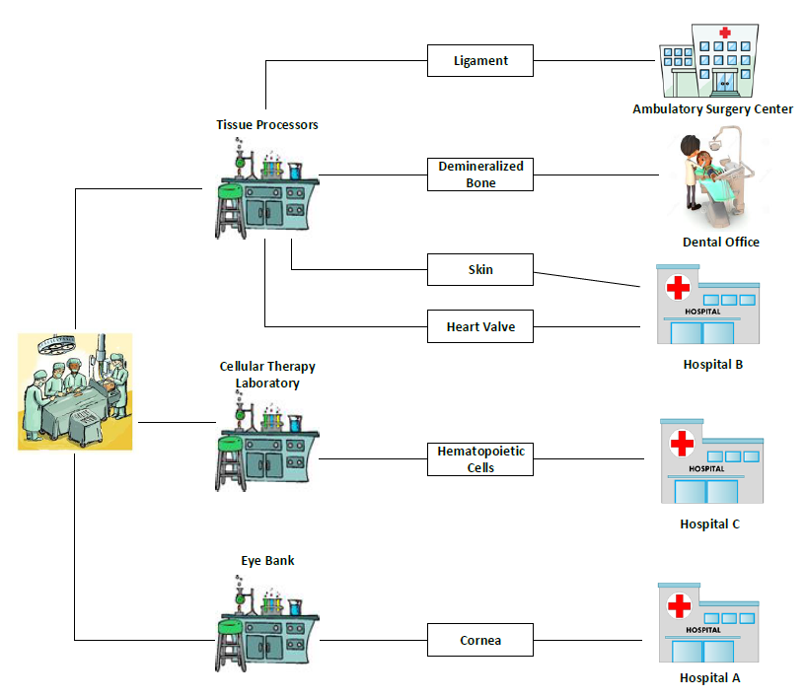

Slide 10
HCT/Ps Examples
Bone
Ligament
Skin
Cornea
Dura Mater
Heart Valves
Sperm, oocyte, embryo
Hematopoietic stem/progenitor cells
Other cellular therapies (e.g. Mesenchymal Stromal Cells, Dendritic cells)

Slide 11
Non-HCT/Ps Examples
Vascularized human organs
Whole blood or blood components
Secreted or extracted human products (e.g., milk, collagen), except semen
Minimally manipulated bone marrow for homologous use
Cells, tissue, organs derived from animals
Invitro diagnostic products

Slide 12
HCT/Ps Regulations
FDA 21 CFR
  Part 1270 (Human Tissue Intended for Transplantation)
  Part 1271 (Human Cells, Tissues and Cellular and Tissue-Based Products)
    Subpart D 1271.290 (Tracking)
  Part 803 (Medical Device Reporting)
  Part 821 (Medical Device Tracking Requirements)
  Part 830 (Unique Device Identification [UDI])

Slide 13
FDA 21 CFR Part 1271.20
“If you are an establishment that manufactures an HCT/P that does not meet the criteria set out in 1271.10(a), and you do not qualify for any of the exceptions in 1271.15, your HCT/P will be regulated as a drug, device, and/or biological product under the act and/or section 351 of the PHS Act, and applicable regulations in title 21, chapter I. Applicable regulations include, but are not limited to, 207.20(f), 210.1(c), 210.2, 211.1(b), 807.20(d), and 820.1(a) of this chapter, which require you to follow the procedures in subparts B, C, and D of this part.”
https://www.accessdata.fda.gov/scripts/cdrh/cfdocs/cfcfr/CFRSearch.cfm?fr=1271.20

Slide 14
FDA 21 CFR Subpart D Current Good Tissue Practice
Section 1271.290 Tracking
“(c) Distinct identification code. As part of your tracking system, you must ensure: That each HCT/P that you manufacture is assigned and labeled with a distinct identification code, e.g., alphanumeric, that relates the HCT/P to the donor and to all records pertaining to the HCT/P; and that labeling includes information designed to facilitate effective tracking, using the distinct identification code, from the donor to the recipient and from the recipient to the donor.”
https://www.gpo.gov/fdsys/search/pagedetails.action?collectionCode=CFR&browsePath=Title+21%2FChapter+I%2FSubchapter+L%2FPart+1271%2FSubpart+D%2FSection+1271.290&granuleId=CFR-2010-title21-vol8-sec1271-290&packageId=CFR-2010-title21-vol8&collapse=true&fromBrowse=true

Slide 15
FDA UDI Rule
FDA established the UDI Rule in Sept. 24, 2013
The UDI rule outlines labeling, data submission, and standard date formatting requirements for all medical devices in distribution and use in the US, unless an exception or alternative applies
Device labelers (manufacturers) must submit certain information about each device to the FDA’s Global Unique Device Identification Database (GUDID)

Slide 16


FDA UDI Rule
Labelling Requirements:
UDI will be supplied in a human- and machine-readable format
A unique alphanumeric or numeric code
Consists of the device identifier (DI) and production information (PI)
PI can consist of expiration date, lot number and serial number.
DI
PI

Slide 17
FDA UDI Labeling Requirements
DI is a mandatory, fixed portion of the UDI that identifies the labeler and the specific version or model of the device
PI is a conditional, variable portion of the UDI that identifies:
    the lot or batch number when manufactured;
    the serial number of the device;
    the expiration date of the device;
    the date (yyyymmdd) the device was manufactured; and
    the distinct identification code required by §1271.290(c) for a human cell, tissue, or cellular and tissue-based product (HCT/P) regulated as a device

Slide 18
FDA UDI Label Issuing Agencies
GS1 (Global Standards One)
HIBCC (Health Industry Business Communication Council)
ICCBBA (International Council for Commonality in Blood Banking Automation)

Slide 19
FDA GUDID
The Global Unique Device Identification Database (GUDID) is a database administered by the FDA that will serve as a reference catalog for every medical device with an identifier.
The labeler of each medical device must submit information to the GUDID by their devices compliance timeline
The public can access information contained in the GUDID through AccessGUDID

Slide 20
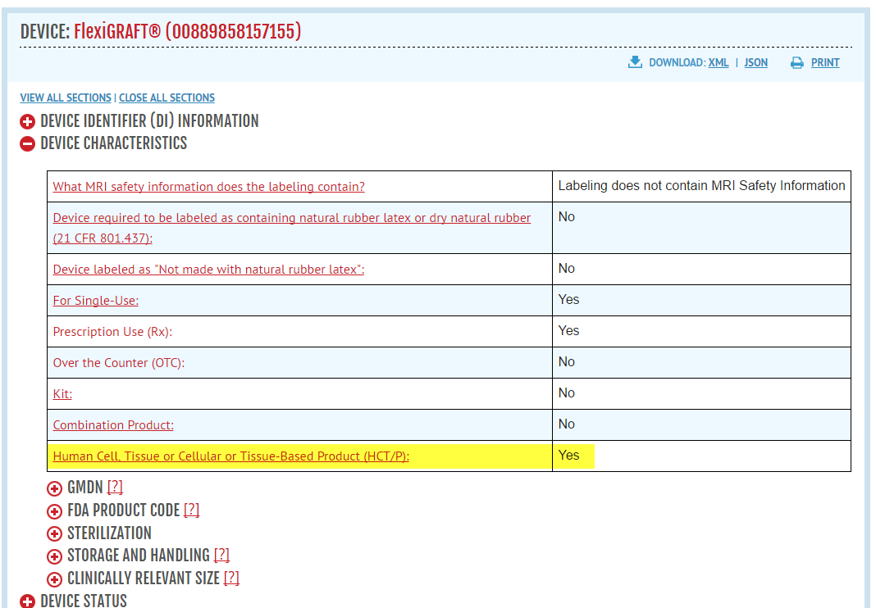
FDA GUDID

Slide 21
UDI and EHRs
2015 Edition Health Information Technology Certification Criteria
specifies that Health IT must be able to electronically perform a number of capabilities including recording and parsing the unique device identifiers associated with a patient’s implantable device, and enabling a user to access the identifiers associated with the UDI (45 CFR 170.315)

Slide 22
EHRs to include UDI
EHR 2015 certification Implantable Device List:
Record Unique Device Identifiers associated with a patient’s Implantable Devices.
Parse the following identifiers from a Unique Device Identifier:
  Device Identifier;
  The following identifiers that compose the Production Identifier:
    The lot or batch within which a device was manufactured;
    The serial number of a specific device;
    The expiration date of a specific device;
    The date a specific device was manufactured; and
    For an HCT/P regulated as a device, the distinct identification code required by 21 CFR 1271.290(c).
Enable a user to access the identifiers listed above.

Slide 23
UDI, HCT/Ps and EHRs
Certified EHRs must be able to electronically capture, store, and parse a medical devices UDI (DI & PI) from the issuing agency’s specifications.
The medical device that contains an HCT/Ps will need the distinct identification code (DIC) parsed from the UDI. The parsing of the DIC is what makes a medical device containing an HCT/Ps different from other medical devices.

Slide 24
Appendix

Slide 25
FDA UDI Label Issuing Agencies
GS1 (Global Standards One)
HIBCC (Health Industry Business Communication Council)
ICCBBA (International Council for Commonality in Blood Banking Automation)

Slide 26
FDA UDI Label Issuing Agencies
GS1
GS1 utilizes a system of standards which includes a Global Trade Identification Number (GTIN) and Application Identifiers (AIs) to appropriately identify and describe a product.
GS1 recommend that the Device Identifier (DI) and the Production Identifier (PI) are used in their entirety for an HCT/P product.

Slide 27
FDA UDI Label Issuing Agencies
GS1
The UDI Device Identifier (DI) is the Global Trade Identification Number (GTIN). The Production Identifiers (GS1s AIs) which pertain to the GS1 standard are as follows:
  (10) Lot/Batch – a 20 character alphanumeric field
  (17) Expiry Date – YYMMDD
  (21) Serial Number - a 20 character alphanumeric field
  (11) Production Date – YYMMDD
GS1 recommends that manufacturers/processors of HCT/Ps using GS1 standards, utilize the Serial number (AI 21 field) to encode the DIC. This is a variable length 20 character alphanumeric field and provides the capability to encode an alphanumeric DIC as needed and in accordance with Part 1271.290(c).
If the manufacturers/processors of HCT/Ps utilizing GS1 standards do not use the recommended serial number as the DIC. The DIC may be the lot number or a combination of serial/lot number. Healthcare organizations will need to verify the data being used with the manufacturer/processor.

Slide 28
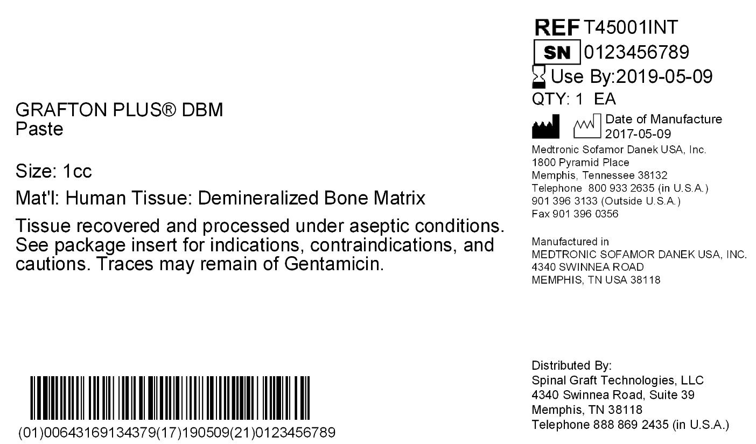
GS1
The components of the GS1 data matrix are as follows:
(01) Global Trade Item Number (GTIN) – unique to a single item type/ Product code/SKU
(17) Expiration date
(21) Serial number - distinct identification code – unique to a single donor
(10) Batch or lot number – unique to a single graft but is not used in this example
The GTIN plus a serial number based Distinct Identification Code constitutes a unique graft identifier (recognized globally).

Slide 29
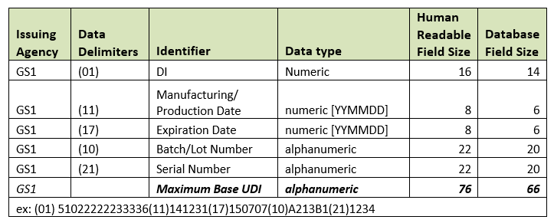
GS1

Slide 30
HIBCC
The HIBCC Standard does not provide a specific production identifier for the distinct identification code. Labelers are permitted by FDA to use a serial number, lot number, or combination of serial and lot number as a distinct identification code. The identifiers fulfilling the role of the distinct identification code will vary between labelers.

Slide 31
HIBCC
Healthcare organizations will need to maintain a reference table on their systems that identifies for each DI, the appropriate production identifiers to be parsed to obtain the distinct identification code. The information will need to be obtained directly from the labeler. To ensure uniqueness, the distinct identification code will need to be associated with the labeler identity.

Slide 32
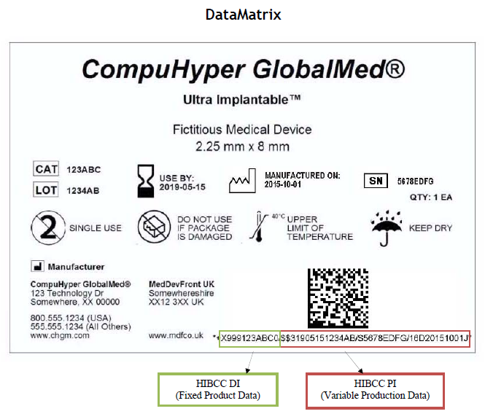
HIBCC

Slide 33
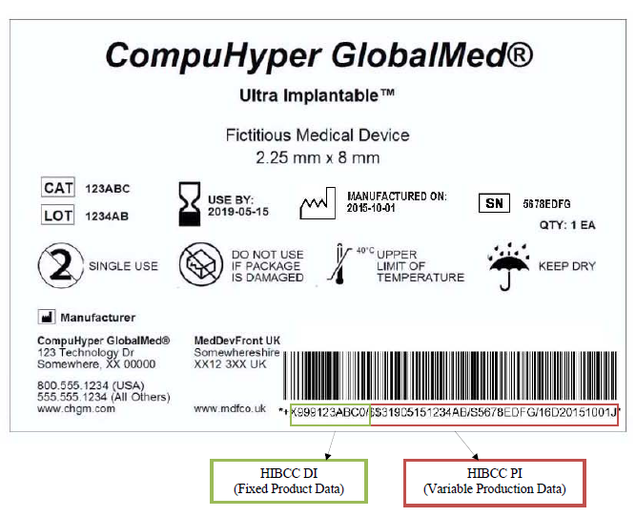
HIBCC Linear Concatenated Barcode

Slide 34
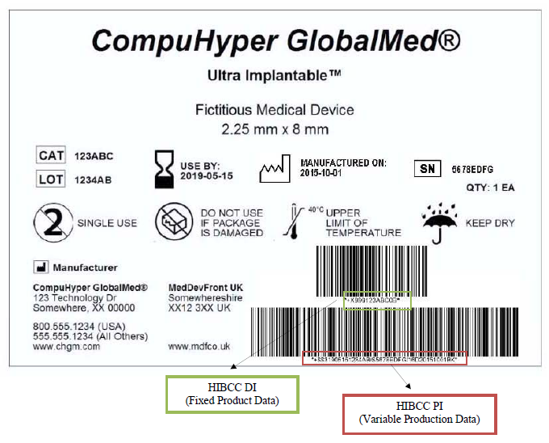
HIBCC Linear Non-concatenated Barcode

Slide 35
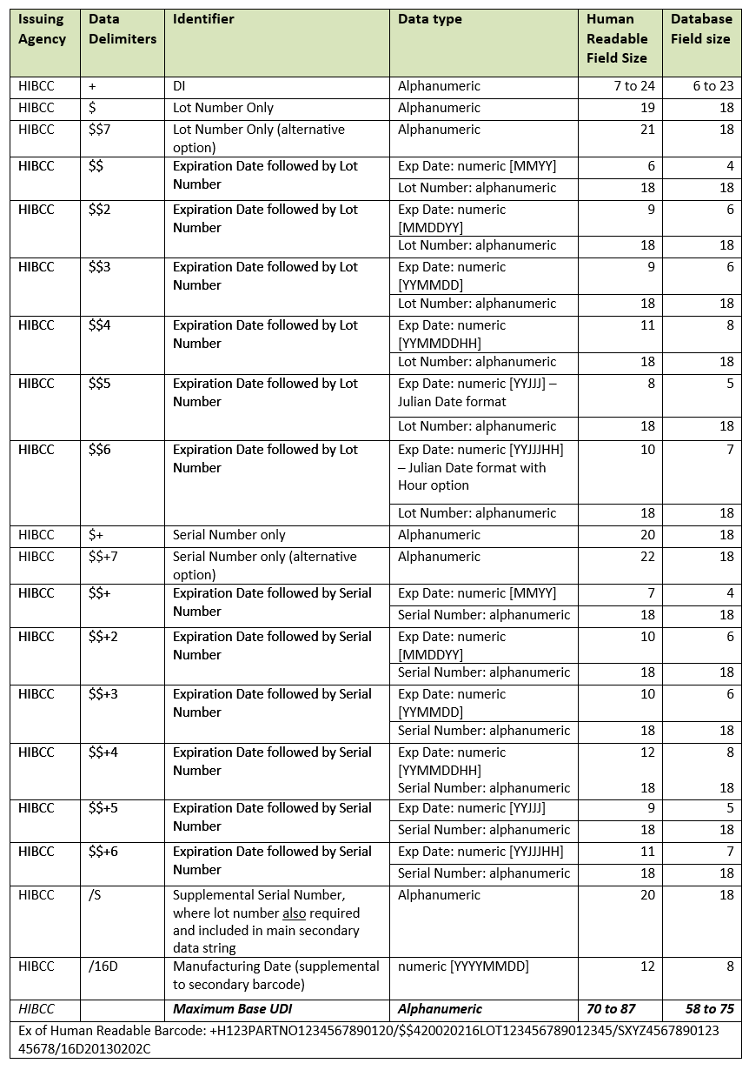
HIBCC

Slide 36
ICCBBA
Uses the ISBT 128 Standard where the distinct identification code is specified as the donation identification number (DIC). The DIC can be parsed directly from the medical device’s production identifier and will always be present. The DIC is globally unique, maps to a unique donor worldwide, and is compliant with ISO/IEC 15459-3.

Slide 37
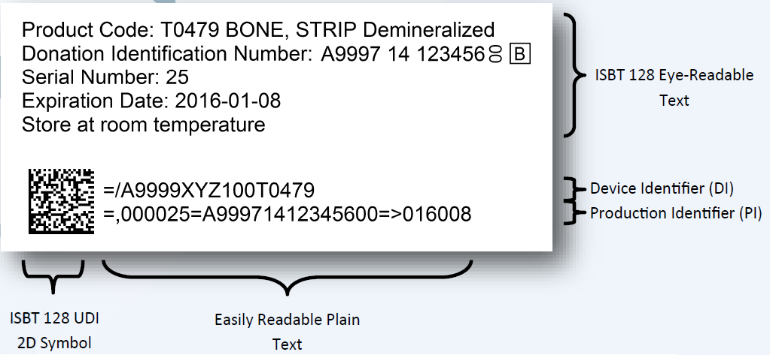
ICCBBA

Slide 38
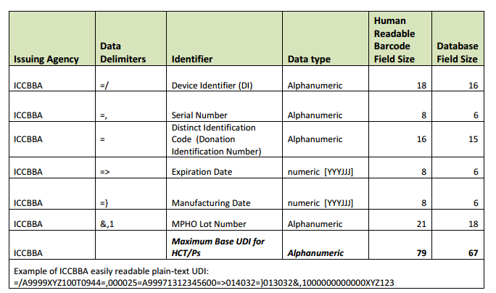
ICCBBA

