Slide 1

Chapter Scholarship Program
2025

Slide 2
Agenda
Importance of education and aligning diverse constituencies
AHRMM education resources
Scholarships
  6 programs
Chapter Committee - structure and operations
AHRMM submission process
4 Resources
  Recorded virtual training
  Scholarship PPT
  Scholarship program document
  Excel budgeting tool

Slide 3
Overview/Principles
AHRMM Led Education
  Understand diverse chapter constituencies.
  AHRMM online and virtual trainings for all levels of knowledge.
  Best suited to provide consistent industry education.
Scholarship program created for chapters
  Guidelines and structure to support your organization.
  Supportive, not required or dictated.
  Flexible for your chapters unique goals and needs.
  Designed for chapters with healthy, surplus budgets.
  AHRMM discounts to chapters that use the program

Slide 4
AHHRMM Member Constituencies
Chapters serve members at three levels
  Early Stage
    Students and 1-3 years experience
  Mid Stage
    3+ years: Technical skills and CMRP
  Leadership
    7+ years: Leadership skills

Slide 5
AHRMM Training: Level 1 – Early Stage
Supply Chain Fundamentals – FREE
  Use as a Prerequisite
  Available on-demand
  https://www.ahrmm.org/education/fundamentals
  Modules
    Introduction to Procurement and Product Value Analysis
    Introduction to Inventory Management
    Introduction to CQO
    The What and Why of UDI
    Become a CMRP

Slide 6
Chapter Scholarships
AHRMM Membership
AHRMM Academy Training
Foundations of Effective Leadership Training
CMRP Test
CMRP Completion
AHRMM Conference Attendance

Slide 7
Scholarship 1: AHRMM Membership
Membership | Dues | Discount | Final
Provider/ Military | $165 | $25.00 | $140
Affiliate | $240 | $36.00 | $204
Exec | $220 | $33.00 | $187
YPA-P | $135 | $20.00 | $115
YPA-A | $195 | $30.00 | $165
Retiree | $109 | $16.00 | $93
Student | $35 | $5.00 | $30
Chapter Budgeting
Proposed number of scholarships: 3
Proposed Recipients
  1 Board Member; 2 Chapter Members
Estimated Cost: $720
With AHRMM Discount: $612

Slide 8
Scholarship 2: AHRMM Academy
Prep for CMRP
Recommended for CMRP prep
Weekly live 1-hour webinars with leaders in the field and on-demand.
https://www.ahrmm.org/education/academy
Modules
  Procurement and Product Value Analysis
  Information Systems and Data Management
  Strategic Planning, Leadership, and Compliance
  Finance
  Procurement and Product Value Analysis
Costs
  Cost per cohort: $129
  AHRMM Scholarship Program discount: 20%
Chapter Budgeting
Proposed number of scholarships: 5
Cost for Five Scholarships: $645
Chapter costs with AHRMM Discount: $516

Slide 9
Scholarship 3: Leadership
Foundations for Effective Leadership
  Cultivate, amplify and strengthen strategic leadership skills.
  Online content
  https://www.ahrmm.org/education/leadership-foundations
  FREE PREVIEW: Building a culture of continuous improvement
Costs
Cost per cohort: $129
AHRMM discount: 20%
Chapter Budgeting
Proposed number of scholarships: 5
Estimated Cost of Five Scholarships: $645
With AHRMM Discount: $516

Slide 10
Scholarship 4: CMRP Test
CMRP is the certification for healthcare supply chain professionals.
Exhibits knowledge of effective management of the quality and affordability of patient care.
Applicants pay for the CMRP upfront.
Scholarship will provide reimbursement upon successful completion.
Prerequisites
  AHRMM Membership, Successful completion of CMRP
Costs
Cost per Exam: $275
AHRMM discount: 20%
Chapter Budgeting
Proposed number of scholarships: 3
Estimated Cost for Three Scholarships: $825
With AHRMM Discount: $660

Slide 11
Scholarship 5: CMRP Completion
This scholarship provides a financial incentive for the successful completion of the CMRP Test.
The cash award is proposed to be $500.
Prerequisites
AHRMM Membership, CMRP Completion, Application
Costs
Cost per Award: $500
Chapter Budgeting
Proposed number of scholarships: 3
Estimated Cost for Three Scholarships: $1500

Slide 12
Scholarship 6: AHRMM Conference
Full Conference Registration | Cost | AHRMM Discount Less $150
Member | $900 | $750
Students* | $150 | $0
Federal Sector (VA, DoD, Military)* | $750 | $500
This scholarship provides financial support to attend AHRMM’s annual Conference.
This scholarship helps pay for AHRMM Conference registration and travel expenses.
Prerequisites
Application, Demonstrate financial commitment.
Note: This scholarship does not cover all costs. Applicants must commit to paying remaining costs.
Costs
Cost per Award: $1500
Chapter Budgeting
Proposed number of scholarships: 3
  1 Board Member, 1 Chapter Member, 1 Student
Estimated Cost for Three Scholarships: $4500
With AHRMM Discount: $4050

Slide 13
Total Proposed Chapter Scholarship Program Budget
Scholarship | Cost | w/ discount | Awards | Total | Total w/ discount
Scholarship 1: Membership | $240 | $204 | 3 | $720 | $612
Scholarship 2: AHRMM Academy | $129 | $103.20 | 5 | $645 | $516
Scholarship 3: Foundations for Effective Leadership | $129 | $103.20 | 5 | $645 | $516
Scholarship 4: CMRP Testing | $275 | $220 | 3 | $825 | $660
Scholarship 5: CMRP Completion | $500 | N/a | 3 | $1500 | $1500
Scholarship 6: AHRMM Conference Attendance | $1500 | $1350 | 3 | $4500 | $4050
Totals | $2773 | $1,980.4 | 22 | $8835 | $7854

Slide 14
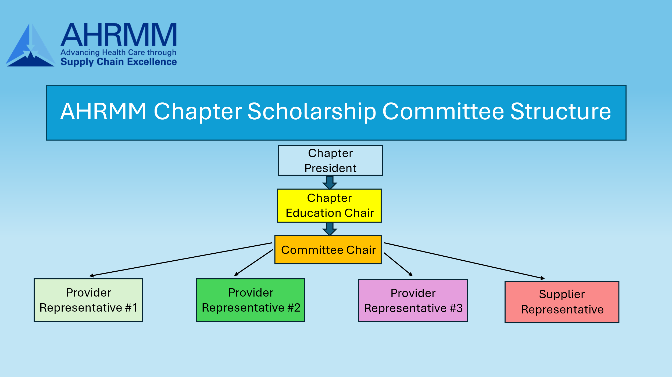
Scholarship Committee Proposed Structure

Slide 15
Chapter Committee Selection Process
Scholarship 1: AHRMM Membership
Application Period: AHRMM membership scholarship applications should be open for 30 days at the beginning of each calendar year (ie., Jan. 1 – Jan. 31).
Application Process: Applicants will complete and submit the “AHRMM Membership Scholarship” application within the application period.
Selection Process: The Scholarship Committee reviews applications, makes selections, and submits recommendations at the first chapter board meeting following the application period. Chapter approves recommendations
Scholarship 2: AHRMM Academy
Application Period: The application period should be for a 30 day period, approximately 90 days in advance of AHRMM Academy cohorts.
Application Process: Applicants will complete and submit the “AHRMM Academy” application within the application period.
Selection Process: The Scholarship Committee will review applications, make their selections, and submit their recommendations approximately 60 days in advance of the AHRMM Academy cohort. Recommendations will be approved by the chapter board approximately 30 days in advance of the AHRMM Academy cohort.
Scholarship 3: Foundations of Effective Leadership
Application Period: The application period for AHRMM Leadership scholarships should be for a 30 day period, approximately 90 days in advance of AHRMM Leadership cohorts.
Application Process: Applicants will complete and submit the “AHRMM Leadership” application within the application period.
Selection Process: The Scholarship Committee will review applications, make their selections, and submit their recommendations approximately 60 days in advance of the AHRMM Leadership cohort. Recommendations will be approved by the chapter board approximately 30 days in advance of the AHRMM Leadership cohort.
Scholarship 4: CMRP Test
Application Period: There is no set period for CMRP Test scholarships.
Application Process: Submit validation of their successful completion of the CMRP along with a receipt for their test and complete an application.
Selection Process: The Scholarship Chair presents the application to the chapter board for reimbursement approval. The chapter should promote and recognize the new CMRP recipient through their website, social media, newsletters.
Scholarship 5: CMRP Completion
Application Period: There is no set period for CMRP Completion scholarships.
Application Process: Applicants submit validation of their successful completion of the CMRP and complete an application.
Selection Process: The Scholarship Chair will present the application to the chapter board for approval. The chapter should also promote and recognize the new CMRP recipient through their website, social media, newsletters, etc.
Scholarship 6: AHRMM Conference Attendance
Application Period: The application period for AHRMM Conference Attendance should be for a period of 15 days at least 60 days before the AHRMM Conference. Best practice is to open the application period at the chapter Spring Conference to promote the AHRMM Conference and align with student competitions and events.
Application Process: Applicants will submit complete and submit the “AHRMM Conference Attendance” application.
Selection Process: The Scholarship Committee will review applications, make their selections, and submit their recommendations at the first chapter board meeting following the application period. Recommendations will be approved by the chapter board 30-60 days in advance of the AHRMM Conference.

Slide 16
AHRMM Scholarship Application Process
Reach out to Emily Milkes, AHRMM Membership Specialist, at emilkes@aha.org.
Provide the following information:
  Scholarship Awarded
  Number of Scholarships Awarded
  Recipient First and Last Name
  Recipient Email Address
  Recipient Mailing Address
  For Membership Scholarships, appropriate member type: https://www.ahrmm.org/get-involved/membership/join.
  First and Last Name or Organization Name of the person making the payment
  Any additional information (i.e. PO Number) that you may want included on the invoice
AHRMM Staff will then review and create an order for the membership or event registration. AHRMM discounts will also be applied at this time.
A PDF invoice(s) will be sent back to the Chapter. This will include instructions on how to pay online by credit card, by check/mail, or over the phone.
Once paid, the recipient will have access to the membership or event registration purchased. AHRMM Staff will send instructions on how to access to the recipient.

